Slide 1

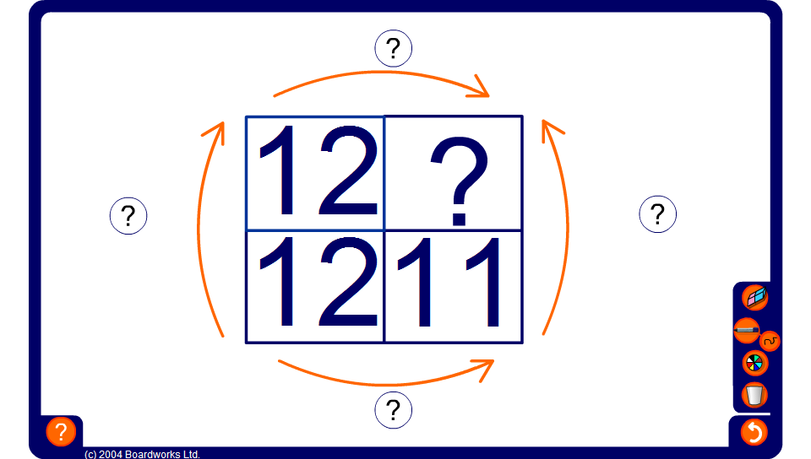


Using scale factors and direct proportion
Notes:
Tell pupils that the two numbers across the top are in the same ratio as the two numbers underneath.
Scale the numbers in either direction to find the value of the missing number.

